Slide 1
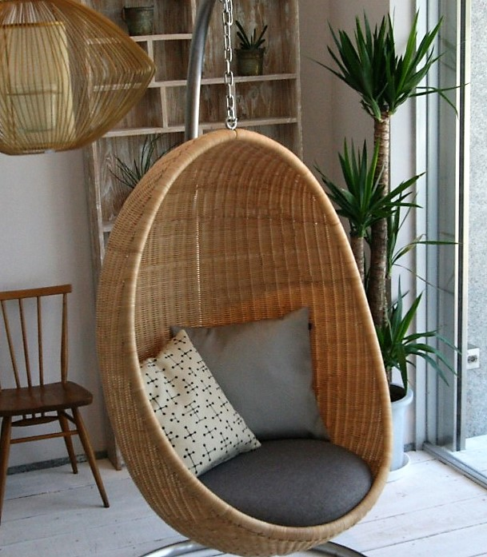
The Egg Lounge Chair

Slide 2
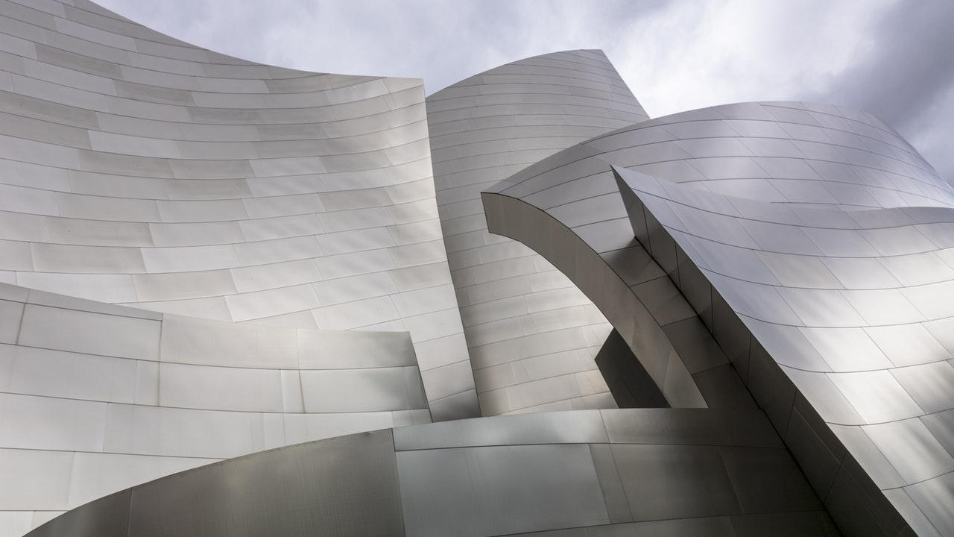
Problem Statement
The phrase "egg chair" conjures up a midcentury image of a sleek, round, pedestaled seat, shaped exactly like an egg, but with a cushioned hollow in the center. The design of an egg chair is appealing as well as comfortable and has a very modern feel to it. However, every egg chair that we have come across through research does not have the compact leg rest feature attached. There are a lot of egg chairs with separate leg rests but none have been designed to have an attached leg rest. As a result, we have decided to add a unique leg rest feature to our egg chair.

Slide 3

Everyone enjoys Comfortable Seating
The oval shell is made of a aluminum composite that curves around the person sitting in it, giving the chair its famous cozy, intimate feel. However an additional component needed to be added such as the leg rest to provide that extra level of comfortability. A very well-known culprit that contributes to the development of varicose veins and lymphedema is the American sedentary lifestyle, that is simply sitting in a chair. In order to ensure healthy circulation, leg elevation is essential to preventing unwanted pain from an everyday practice.

Slide 4

Importance of Leg Rest Innovation
Wellness in the workplace is becoming a big topic! Companies are finding inventive ways to ensure that their employees are comfortable in the workplace and stay in good health. In our design, we decided to add a compact leg rest feature to the egg chair design. Elevating leg rests allow individuals to change the angle of orientation of the legs and/or footrests relative to the seat, extending the knee. In order to provide clear movement at the knee joints, the pivot points of the ELR’s should be positioned as close to the knee joints of the individual as possible. Elevating the legs above the level of the left atrium by approximately 300 mm is generally recommended as part of the management of oedema. This allows for a reduction in venous pressure and increases arterio-venous pressure and capillary flow. To achieve this position in our egg chair, elevating leg rests are usually used in combination with tilt. Recent research has shown that in a control group of individuals, using elevating legrests and tilting more than 30° in combination with full recline, significantly improved lower limb haemodynamic states, as measured by near-infrared spectroscopy (Fujita, et al 2010).

Slide 5
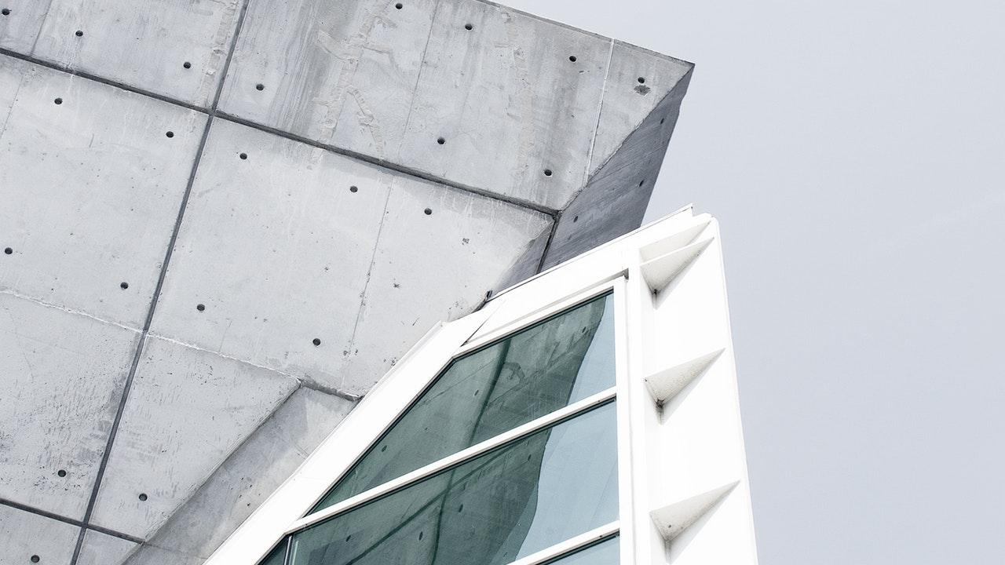
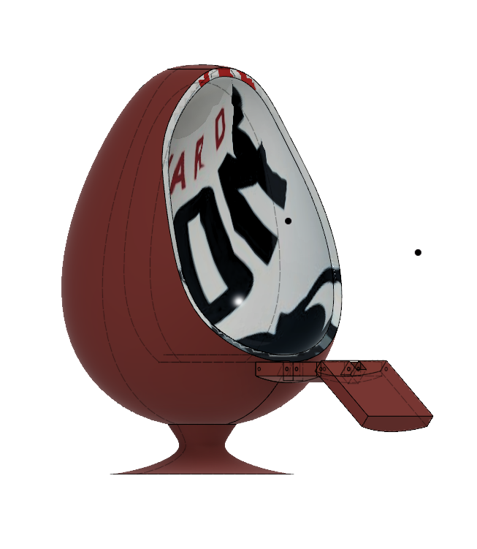
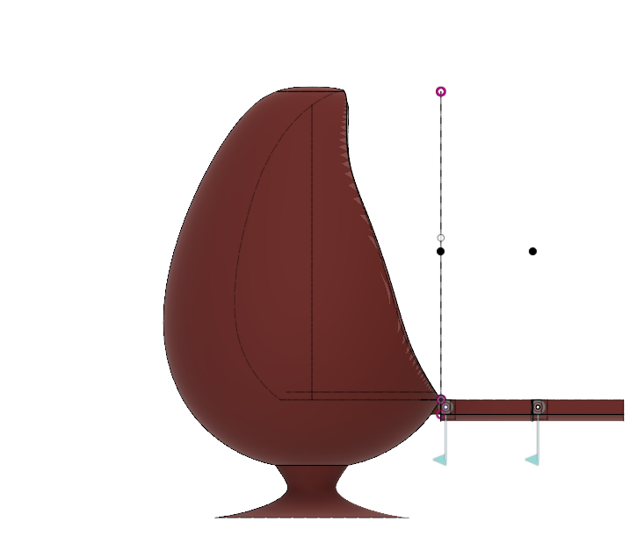
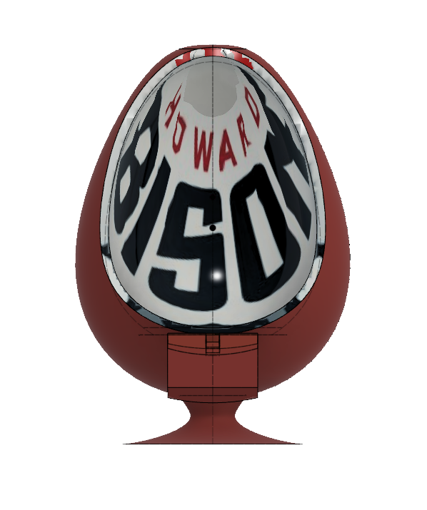
Fusion 360 Design

Slide 6
Reasoning for the modification
1- Cost
The average cost for a chair like ours ranges from $800 to $1400 in addition to foot rest costs which range from $100 to $170
In order to reduce the cost we decided to make the modifications using less of the expensive material (aluminum and fiberglass) and substitute it with a cheaper alternative (Cushion and Fabric)

Slide 7
Reasoning for the modification
2- Convenience and practicality
Less storage space or area (compact)
Having a combined product instead of two
Adjustable leg-rest unlike the traditional fixed leg-rest
Ability to fold the leg-rest when it is not needed

Slide 8

Design Ideas
Extended piece roughly length of thigh, second piece connected via hinge that can fold and unfold out
Shorter extrusion, 2 hinge system to fold up and under
A drawer that will be underneath and can be pulled out and then returned

Slide 9
Criteria | Design 1: Single Hinge | Design 2: Double Hinge | Design 3: Drawer
Cost | 2 | 3 | 1
Buildable | 3 | 2 | 1
Ease of Use | 3 | 2 | 2
Durability | 3 | 2 | 1
Comfortability | 2 | 3 | 2
Appearance | 1 | 2 | 3
Analysis Capability | 2 | 3 | 1
Analysis Results | 2 | 3 | 1
Total | 18 | 20 | 12

Slide 10
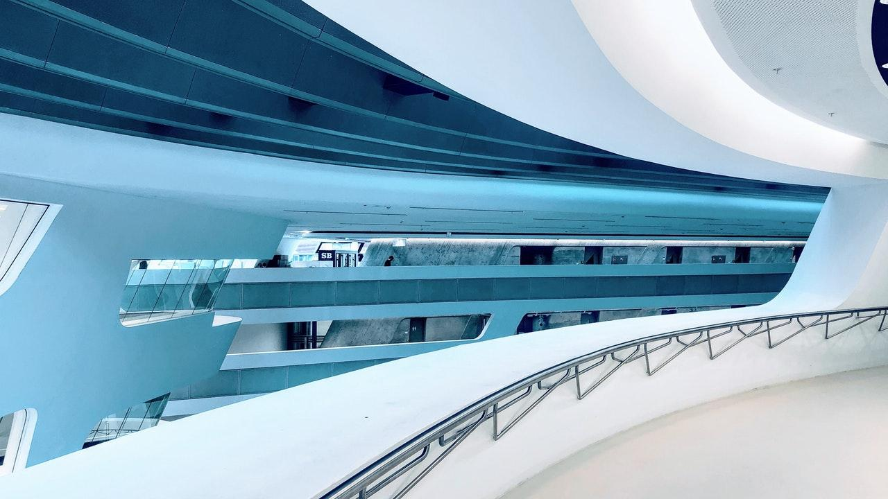
Statistics
Average Height of Men 5’9”
Average Height of Women 5’4”
Average Weight of Men 195.7 lb
Average Weight of Women 166.2 lb
Better to go with men’s height to accommodate a larger audience
Maximum force on chair will be 195.7 lb which is approximately 890 N
Average length of the leg is about 75 cm (2.46ft) so this serves as the minimum length of the leg rest.
Using the fact that the leg is 20% of the total body mass and trunk is 80%, we assumed discrete load distribution.
Then 40% acts on the curved part while 40% acts on the seat and 20% acts on the leg rest

Slide 11
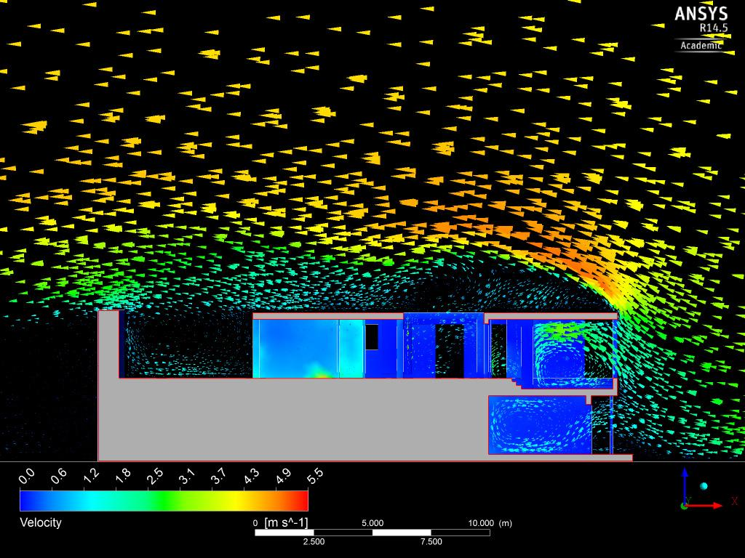
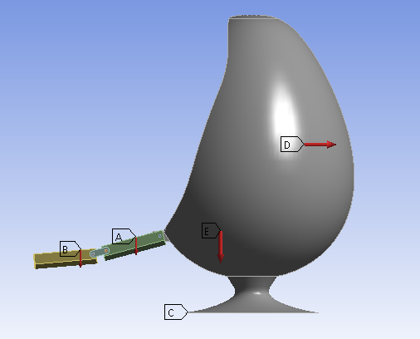
Analysis

Slide 12
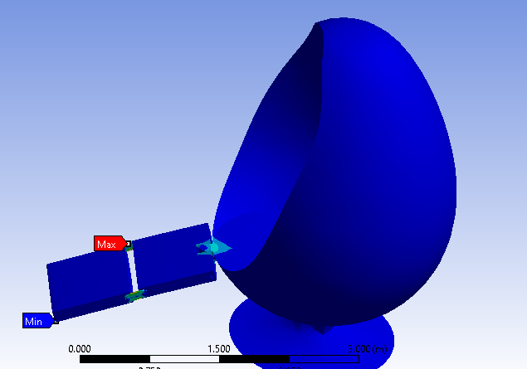
Analysis

Slide 13
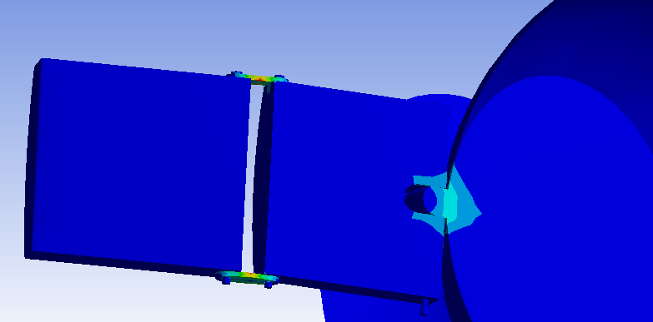
Analysis

Slide 14
Stress Analysis Result
Applying the load as shown in the previous slide, the maximum stress occurred at the hinges
Stress concentration occured at the hinges and the connector of the egg chair and leg-rest
Max. stress found was 9.4966e+005 Pa in the connector
Yield strength of Aluminum Alloy = 2.8e+08 Pa
Safety factor = 295
Structure is safe

Slide 15
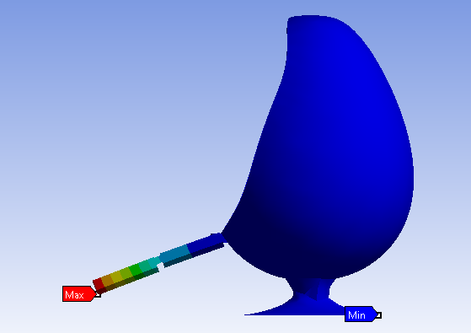
Analysis

Slide 16
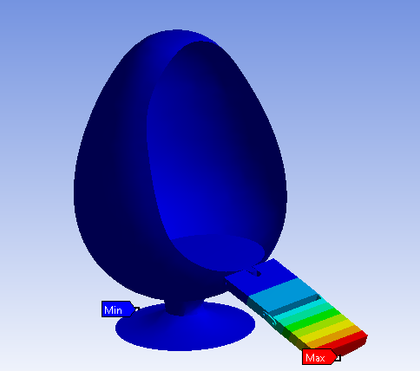
Analysis

Slide 17
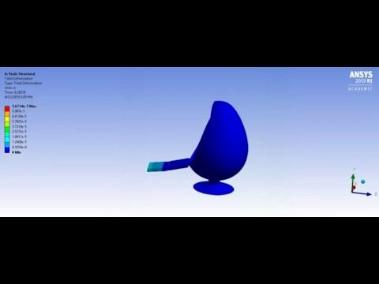
Analysis

Slide 18
Strain Analysis Result
The maximum strain in the structure occurred at the tip of the leg-rest
The max. Strain was 1.346e-005 which is 0.00134%
This deformation is very small so the structure with that dimension is practical and safe

Slide 19
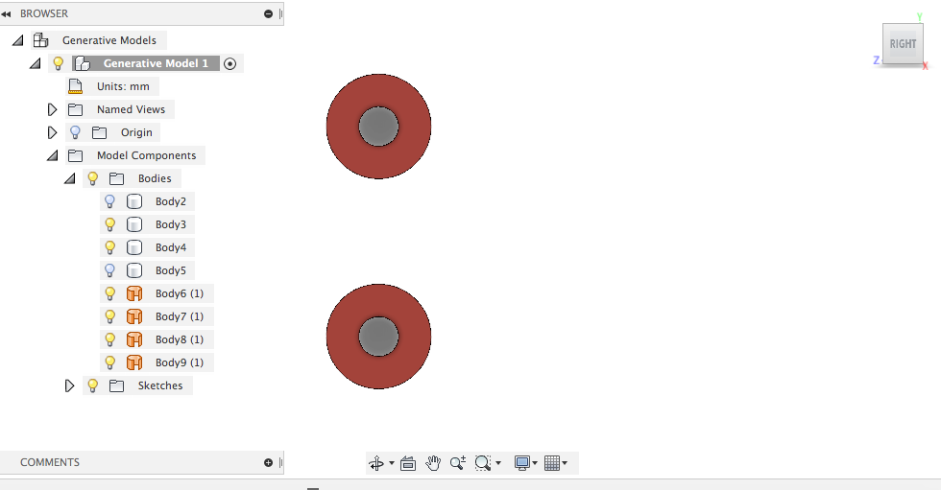
Generative Design
Preserved geometry
Start a new sketch
Draw circles
Extrude intersection

Slide 20
Generative Design
Creating Obstacle Geometry
Add a box
Add patch
Fluid volume to fill the void
Extrude to make sure that the AI would not block the holes
New components
Preserved geometry
Obstacle geometry

Slide 21
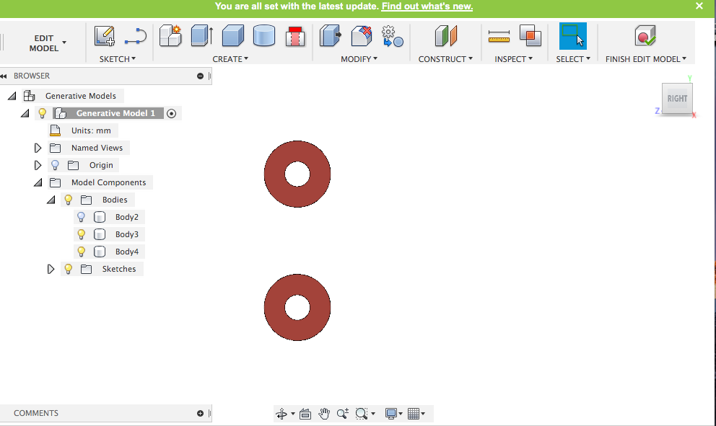
Generative Design

Slide 22
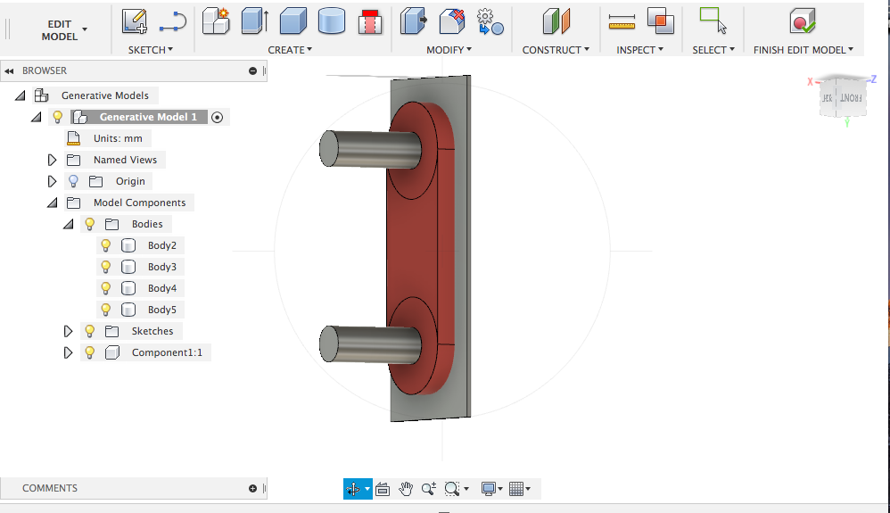
Generative Design

Slide 23
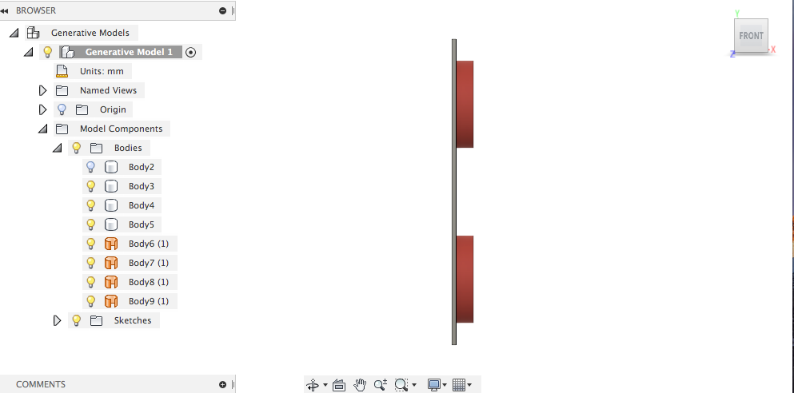
Generative Design

Slide 24
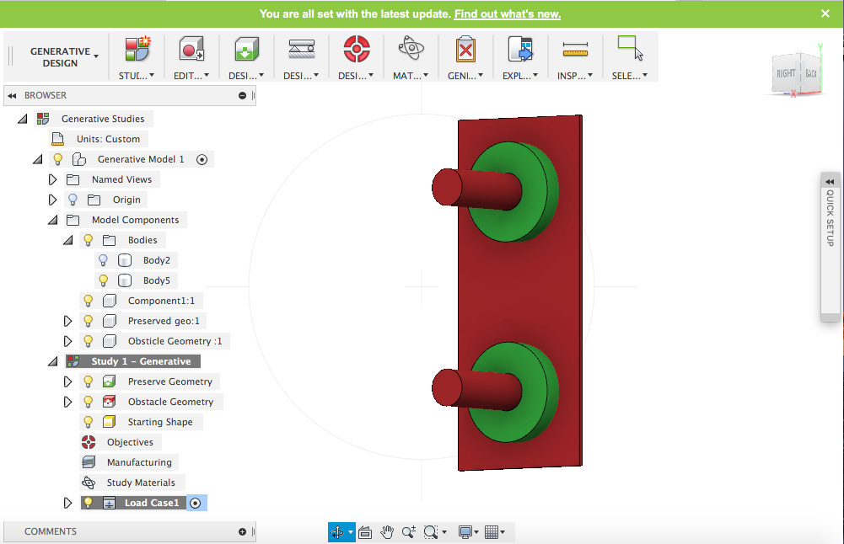
Generative Design

Slide 25
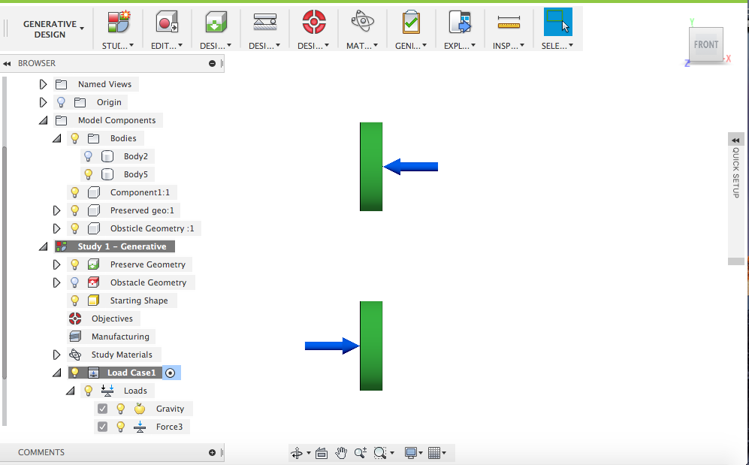
Generative Design

Slide 26
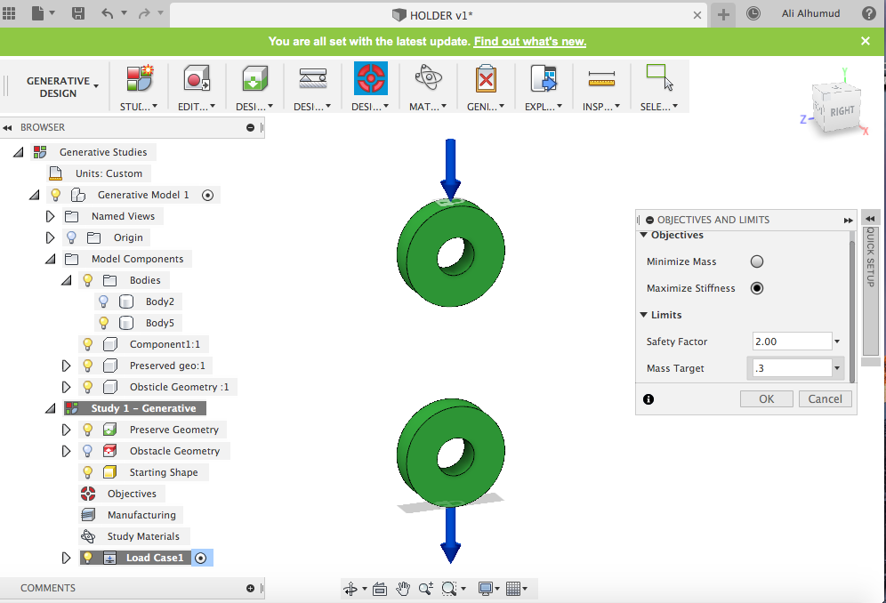
Generative Design

Slide 27
Starting shape
Starting shape
Optimize an exciting shape
Consider a close design space
Traditional topology optimization
No starting shape
Create unique design that was not considered
Open design space
Optimal design

Slide 28
Conditions objective and outcome
Set up constraints (no movement or deformation)
Applied load(moment ,pressure )
Objective of the design(Min mass, max stiffness)
Manufacturing constraint
Material (Aluminum)

Slide 29
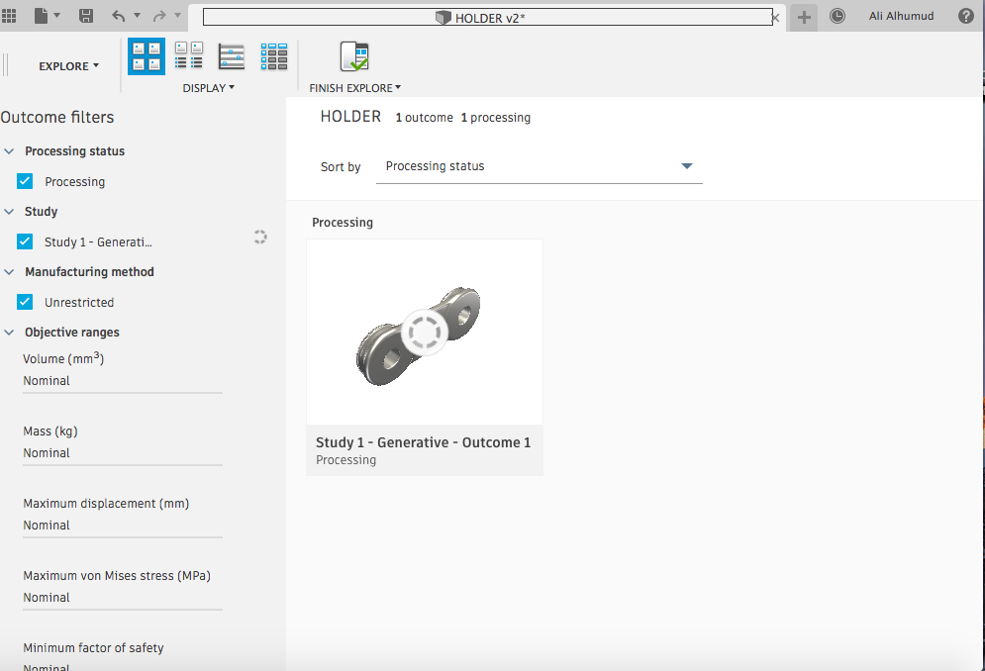
Generative Design

Slide 30
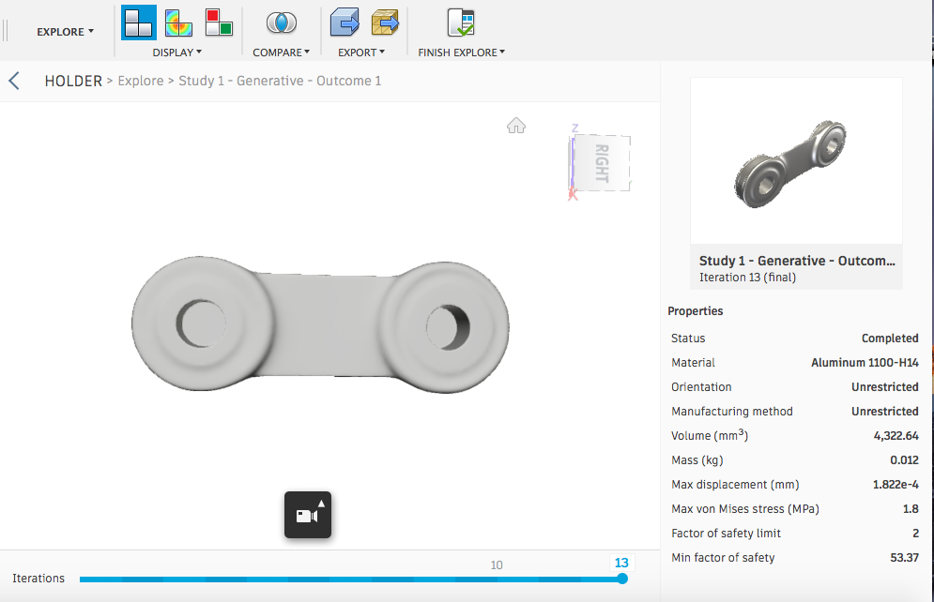
Generative Design

Slide 31
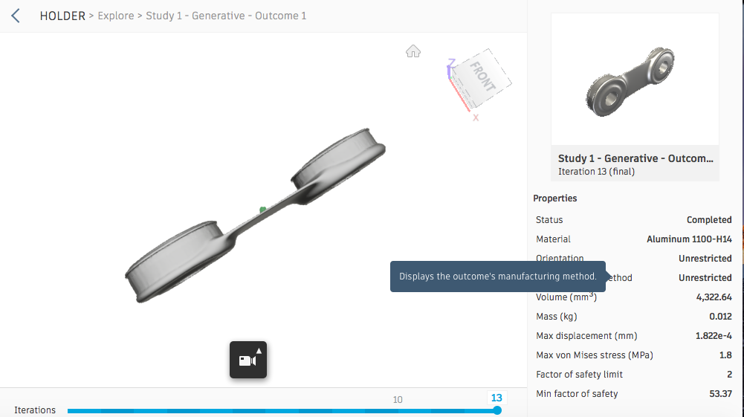
Generative Design

Slide 32
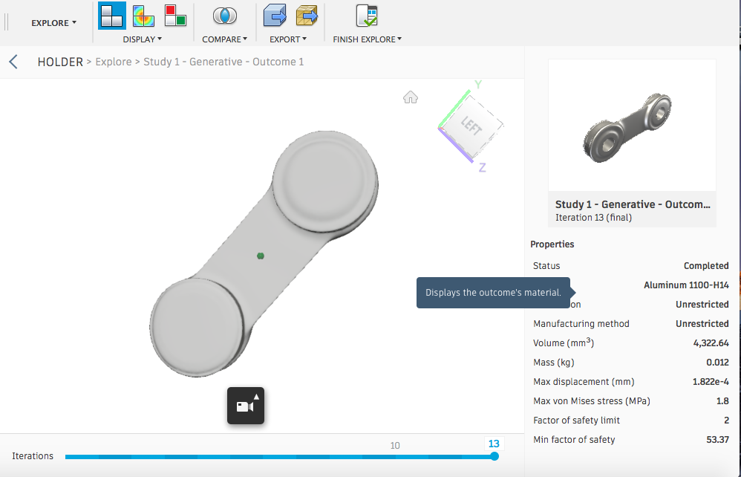
Generative Design

Slide 33
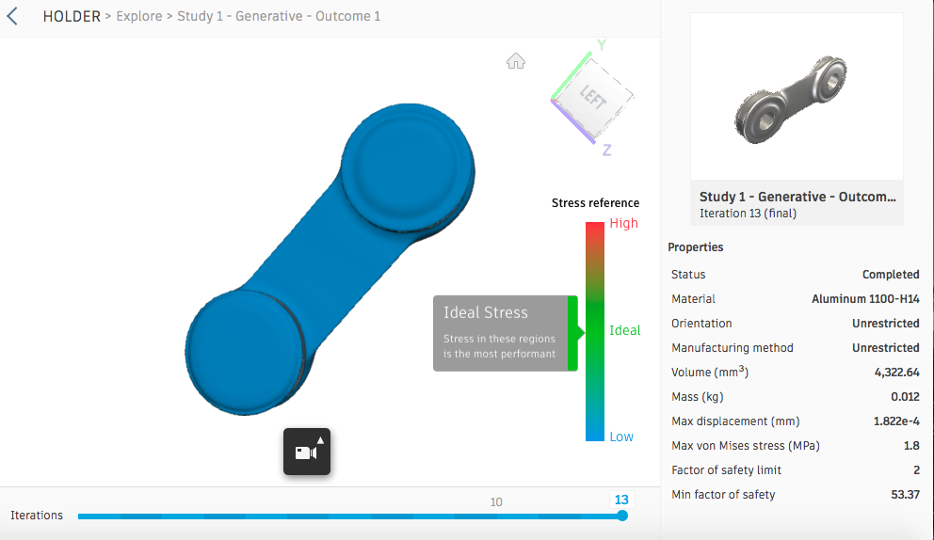
Generated design

Slide 34
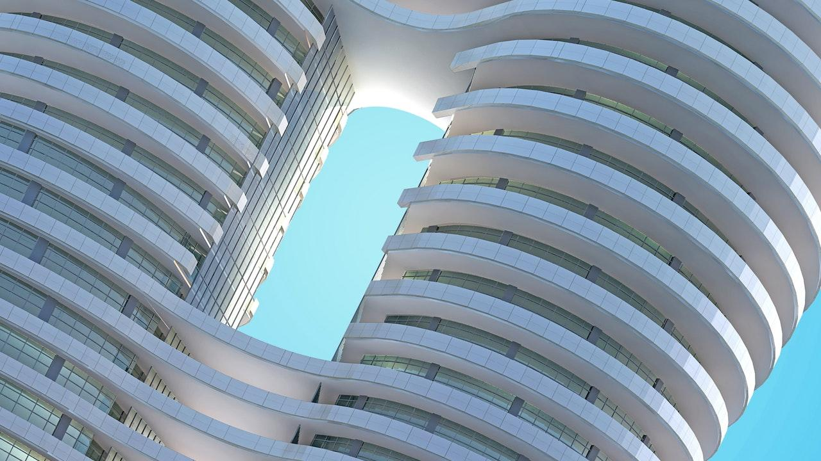
THANKS!
Q & A

